Slide 1



How will school help me choose my options?

Slide 2
Half Term | Date | Event
3 | 16th January 26th January 3rd February | Option launch assembly Year 9 Exams Y9 Options Evening Complete options passport in form
4 | Mon 9th March Friday 13th March | SLT Review & Options Day (Report 2) Final option forms due in

Slide 3
Student Preparation
In January school will be preparing your child to be able to choose their options by:
1.Assemblies introduce the option programme
2.Options trial run to help the option blocks to be produced
3.Options booklet shared with students and parents
4.4 to 5 hours of FFL lessons looking at careers and entry requirements
5.Options videos for each GCSE subject
6.Completion of options passport
On 9th March students and parents will have an interview with a senior leader in school and receive subject reports with current working grades and attitude data

Slide 4
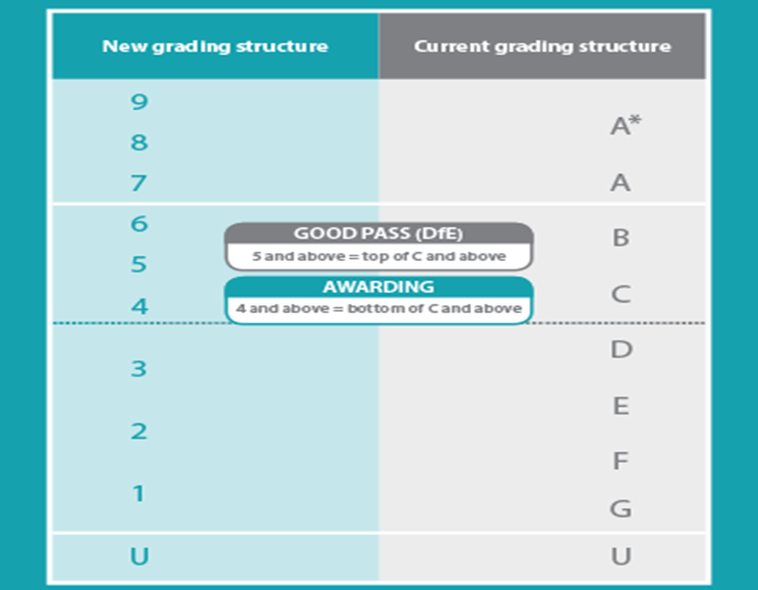
Grading
Structure

Slide 5
What subjects are compulsory?
English
English Literature
Maths
Science
The following are not examined: Cultural studies
ICT
Citizenship (Fit for life)
PE

Slide 6
How many options can I pick?
3 Options
1 must be History, Geography or Spanish (you can do all three)
Only 1 technology

Slide 7
What subjects can I choose from?
Art Business Studies Ethics
D&T (Graphics or Textiles) Spanish Drama
Food & nutrition Catering Health & Social
PE Geography I-media Engineering design
Music technology History Triple Science

Slide 8
Good choices
There are many things to consider when choosing an subject:
How well are they doing (current attainment data)
Advice from staff
Do they enjoy the lesson?
Future Career
Students are going to be studying the subject for the next 2 years so they must enjoy the lessons. The more they enjoy the subject the harder they will work and the better grades they will achieve.

Slide 9
Poor choices
There are many reasons why not to choose a subject:
I like the teacher I get this year (it maybe different member of staff next year)
My friends are doing the subject
You think it will be easy
You know someone who has studied the course before
The title sounds good but you do not know anything about it

Slide 10
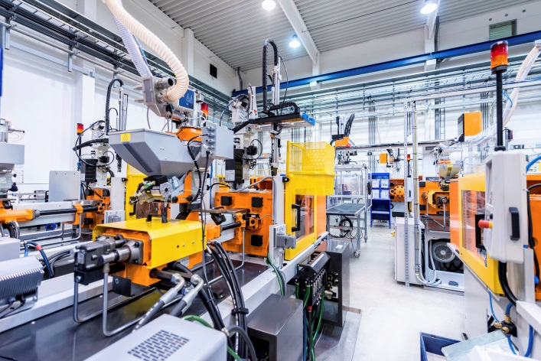



Labour Market Information
The four fastest growing employment sectors in the
North East are:
Health and life sciences
Manufacturing
Engineering/Renewable Energy
Digital and Gaming industry
Fit For Life
John Spence Community High School
Notes:
Sean Longstaff
Started John Spence: 2009
Left John Spence : 2014 with 8 A* - C GCSE’s
Occupation: Footballer
First Club: North Shields Juniors Under 6
Newcastle United Development Squad: Aged 7
Signed for Newcastle as a Schoolboy: Aged 8
Signed 2 year scholarship in: 2014
Reserve team debut as a 17 year old: 2015
Completed scholarship 2016
Newcastle United Scholar of the Year: 2015 & 16
1st professional contract 2016
Now playing in the Under 23’s where he has scored 10 goals in 13 appearances this season.
Next step could be going out on loan to gain first team experience or breaking through to the first team at Newcastle.

Slide 11


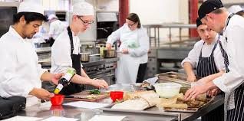
Labour Market Information
Which industries will need employees when I leave school?
Low Carbon Economy – Nissan Leaf, Biomass, Energy – wind, wave, tidal
Health and Social Care
ICT and Digital
Engineering and Manufacturing
Construction
Hospitality
Science
Tourism
Fit For Life
John Spence Community High School
Notes:
Sean Longstaff
Started John Spence: 2009
Left John Spence : 2014 with 8 A* - C GCSE’s
Occupation: Footballer
First Club: North Shields Juniors Under 6
Newcastle United Development Squad: Aged 7
Signed for Newcastle as a Schoolboy: Aged 8
Signed 2 year scholarship in: 2014
Reserve team debut as a 17 year old: 2015
Completed scholarship 2016
Newcastle United Scholar of the Year: 2015 & 16
1st professional contract 2016
Now playing in the Under 23’s where he has scored 10 goals in 13 appearances this season.
Next step could be going out on loan to gain first team experience or breaking through to the first team at Newcastle.

Slide 12



Labour Market Information
Where can I get more information and advice?
Fit For Life
John Spence Community High School
Notes:
Sean Longstaff
Started John Spence: 2009
Left John Spence : 2014 with 8 A* - C GCSE’s
Occupation: Footballer
First Club: North Shields Juniors Under 6
Newcastle United Development Squad: Aged 7
Signed for Newcastle as a Schoolboy: Aged 8
Signed 2 year scholarship in: 2014
Reserve team debut as a 17 year old: 2015
Completed scholarship 2016
Newcastle United Scholar of the Year: 2015 & 16
1st professional contract 2016
Now playing in the Under 23’s where he has scored 10 goals in 13 appearances this season.
Next step could be going out on loan to gain first team experience or breaking through to the first team at Newcastle.

Slide 13
How are the option blocks made?
A google quiz will be sent out on google classroom
Fill it in and write which combination of subjects you can not do
This is repeated at least 3 times

Slide 14
Option meeting and deadline for forms?
You and your parent/carer must attend a meeting with SLT on Monday 9th March
You must hand form in on or before Friday 13th March to Mrs Clay

