Slide 1
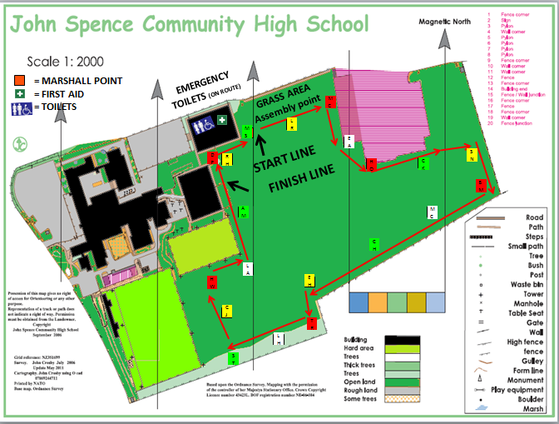
JOHN SPENCE FEEDER SCHOOL RUN Monday 26th June 2017
.
1 LAP – 1 MILE |  | Yr 4 / Yr5 / Yr6 | 1.30 – 3.00
Rec / Yr1 / Yr2 / Yr3 | 10.00 – 11.30 | 3 LAPS – 3 MILES
The aim of the day is for all our feeder schools to come together to celebrate sport on the opening day of National School Sports Week http://www.youthsporttrust.org/events-awards/events/national-school-sport-week.aspx
Equipment Check List
Appropriate Footwear
Sports Clothing/PE Kit
Sun cream / Hat
Drink (no drinks provided)
Warm Clothes for before/after
Waterproofs
Medication if needed
Grass Area behind Sports hall – Assembly Point
Due to building work at school, please access the field via the sports hall. We will assemble behind the sports hall on the grass verge to warm up
Staff and parental helpers are more than welcome to take part in the run. We look forward to seeing you all on Monday and enjoying the start of National School Sports Week
In the event of poor weather, or uncertain conditions, a Risk Assessment will be remade at 8.00am on the morning of the run. In the event of a cancellation, schools will be notified by phone to their school office after this 8.00am inspection.

Slide 2
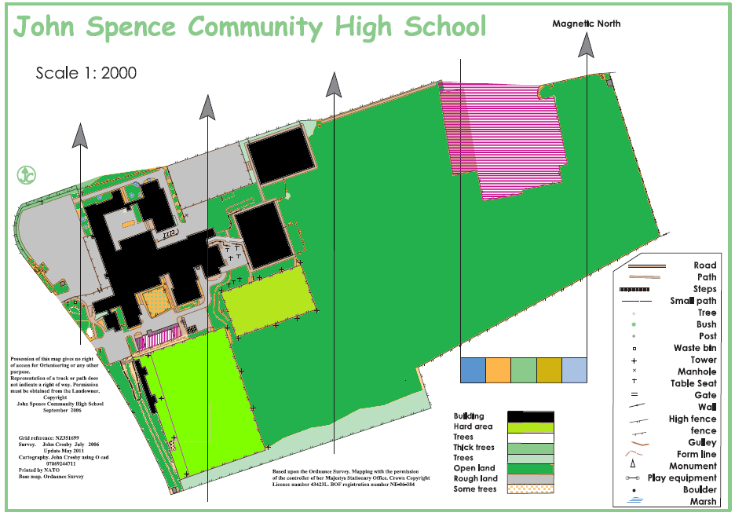
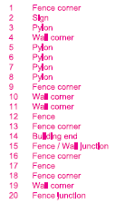
= MARSHALL POINT
= FIRST AID
= TOILETS
EMERGENCY TOILETS (ON ROUTE)
GRASS AREA
Assembly point
MC
MS
LR
EA
DP
RH
START LINE
SN
HO
CK
FINISH LINE
BM
AM
MC
CH
LA
HW
EH
CJ
TR
LH
ST

