Slide 1
LESSON 3
Rotation 1

Slide 2
HIGH STEPPER

Slide 3
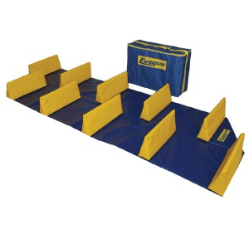
HIGH STEPPER
Run through the high stepper to the red cone and back

Slide 4
TARGET HOOP

Slide 5
TARGET HOOP
20
10
15
5
Points scored for different hoop after 1 shot and collect

Slide 6
HOOP FLIP

Slide 7
HOOP FLIP
Run to the red cone and back, flipping each hoop over your full body along the way

Slide 8
NETBALL SHOOT

Slide 9
NETBALL SHOOT
Run to the red cone and then shoot for the hoop

Slide 10
LESSON 3
Rotation 2
Repeat 4 activities of classes choice

