Slide 1
LESSON 2
Rotation 1

Slide 2
AGILITY RUN

Slide 3
AGILITY RUN
IN OUT IN
Run through the course back and forth with figure of 8 in-between

Slide 4
BEANBAG DRIBBLE

Slide 5
BEAN BAG DRIBBLE
Dribble the beanbag in a figure of 8 course

Slide 6
THROW & CATCH

Slide 7
THROW AND CATCH
Pupils work in pairs to throw and catch the ball backwards and forwards

Slide 8
SPEED BOUNCE

Slide 9
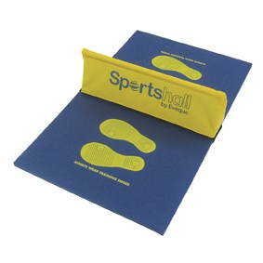
SPEED BOUNCE
Run through the course, perform x3 speed bounces at each station

Slide 10
LESSON 2
Rotation 2

Slide 11
HURDLE RACE

Slide 12
HURDLE RACE
Run to the red cone and back, jumping over the hurdles on the way there and back

Slide 13
HURDLE JUMP

Slide 14
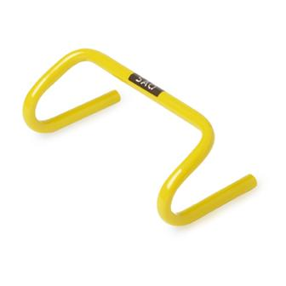
HURDLE JUMP
JUMP
RUN
Jump two footed through the course of hurdles then run back

Slide 15
STEP ATTACK

Slide 16
STEP ATTACK
Run through the course, going over each step along the way

Slide 17
UP AND UNDER

Slide 18
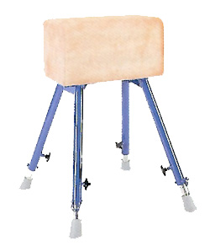
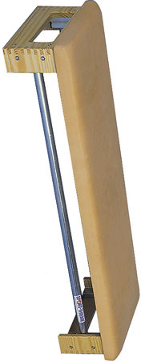
UP AND UNDER
under
over
over
Run through the course, going either over or under at the obstacle

