Slide 1
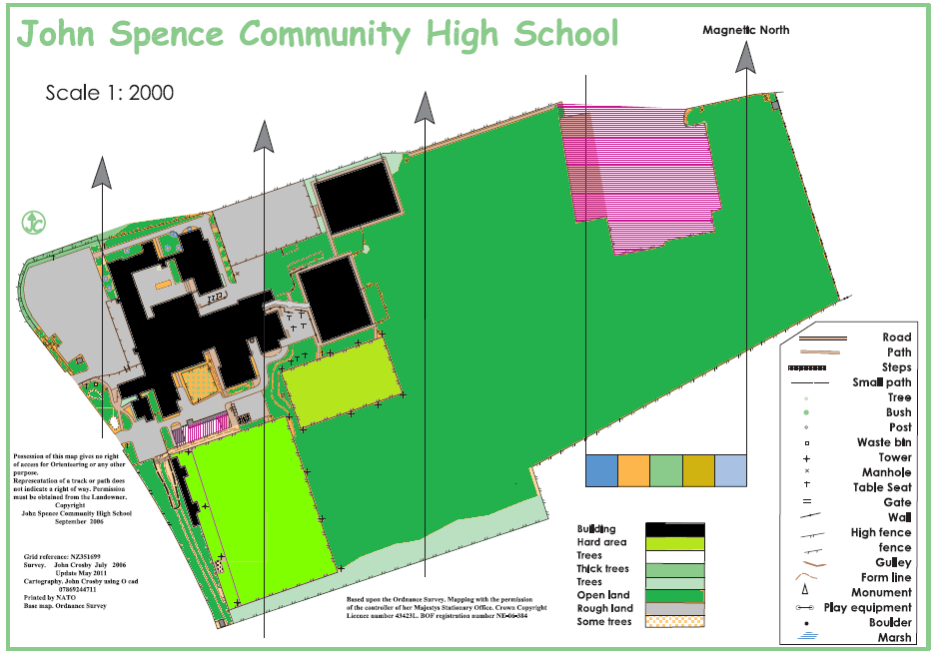
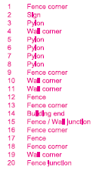
= MARSHALL POINT
= FIRST AID
= TOILETS
EMERGENCY TOILETS (ON ROUTE)
GRASS AREA
Assembly point
MC
MS
LR
EA
DP
RH
START LINE
SN
HO
CK
FINISH LINE
BM
AM
MC
CH
LA
HW
EH
CJ
TR
LH
ST

